Slide 1
Project Title: Development of Dynamic Path Replanning Algorithm for Autonomous Mobile Robots
Project No. B090
Presented by: Huang ZhiWei (U1522408L)
Supervisor: Professor Low Kim Huat
Notes:
Good afternoon everyone, I am Huang ZhiWei and today I will presenting on my Final Year Project titled Development of Dynamic Path replanning algorithm for autonomous mobile robots

Slide 2
1.
INTRODUCTION
Background, Motivation, Objective & Scope
Notes:
I will start off with the introduction, covering background, motivation, objective and scope of the project

Slide 3


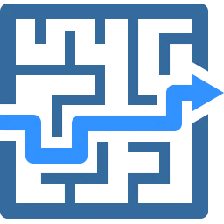

Background
One of the most popular research topics in the area of robotics.
Generate a collision-free path between a specified start and end state in a configuration space
Applications in mobile robots and artificial intelligence for video games
Notes:
Path planning is one of the most popular research topics in the area of robotics. Traditionally, the focus of path planning is to generate a collision free path between a specified start and end state in a configuration space. However, in recent years the focus has evolved to optimal path planning in the least possible time. Path planning has various applications, mainly in the robotics field and artificial intelligence for video games.

Slide 4
Motivation
Majority of path planning algorithms are not applicable in changing and unknown environments
Most path planning algorithm research mainly concentrate only on 2-D configuration spaces
3-D dynamic path replanning implementation onto UAV opens huge opportunities
Notes:
There are 3 main motivation for taking up this project. Firstly, Majority of path planning algorithms require a static and fully known environment, making them inapplicable for many real-world environments which are changing and unknown.
Next, Most path planning algorithm research mainly concentrate only on 2-D configuration spaces, limiting the application to surface robots
Finally, 3-D dynamic path replanning implementation onto UAV opens huge opportunities in smart city applications such as public safety and surveillance, emergency services, traffic management and even delivery

Slide 5
Project Objective & Scope
Objective
To develop an effective and efficient dynamic path replanning algorithm in a 3-D environment with both static and dynamic moving obstacles.
Scope
Literature Review
2-D Development
3-D Development
Replanning process based on a existing path planning method
Implementation scope to single mobile robot
Implementation
Multiple static obstacles, One randomly moving obstacle
Both Robot and obstacle moving at the same and constant speed
Obstacle will move along straight-line path between randomized vertices
Simulation
Notes:
Hence, the project objective is to develop an effective and efficient dynamic path replanning algorithm in a 3-D environment with both static and dynamic moving obstacles.
The scope of the project includes a literature review to study existing path planning algorithms and some of their recently developed dynamic variants, followed by 2-D and 3-D Algorithm development
The Replanning process has to be based on a existing path planning method for easy implementation and the scope will be limited to a single mobile robot
Simulations will present dynamic environments consisting of multiple static obstacles and one randomly moving obstacle. Both the robot and the obstacle are set to move at the same speed and will remain constant throughout the entire run. The obstacle will move along straight-line path between randomised vertices during the path execution phase of the robot.

Slide 6
2.
LITERATURE REVIEW
Reviewing and learning from existing research
Notes:
Now moving on to literature review

Slide 7
Path Planning Algorithms
Sampling based Algorithm
Node based Algorithm
Sampling-based and node-based algorithms are the most commonly used 3-D path planning algorithm for UAV scenarios
Path Planning Algorithms
Model based Algorithm
Bioinspired Algorithm
Notes:
There are a variety of 3-D path planning algorithms such as sampling-based algorithms, node-based algorithms, mathematical model-based algorithms, bioinspired algorithms and even fusion algorithms
Sampling-based and node-based algorithms are the most commonly used 3-D path planning algorithm for UAV scenarios and was studied in further detail.

Slide 8

Sampling-based Algorithms
Animation of RRT process
Rapidly exploring Random Tree (RRT) and its many variants such as RRT*, RRT-connect
Probabilistic Road Map (PRM)
Notes:
Sampling-based algorithms include Rapidly exploring random Tree (RRT) and many other improved variants RRT*, RRT-connect
RRT rapidly searches the configuration space to generate a collision free path connecting the start node and the goal node. As seen in the animation, A tree is constructed using random sampling in the search space with the root as the initial node and expands towards the goal node
Probabilistic road map method is also under sampling-based algorithm

Slide 9

Node-Based Algorithms
Dijkstra’s algorithm
A* algorithm
D* algorithm
Other improved variants of A* and D*.
Animation of A* Algorithm
Notes:
Node based algorithms are one of the oldest path planning techniques. It decomposes the configuration space into a grid and each grid point or node corresponds to a vertex in a graph. These algorithms search the graph from a starting node, exploring adjacent nodes until it reaches the destination node as seen in the animation
Node-based algorithms includes Dijkstra’s Algo, A*, D* and other improved variants of A* and D*

Slide 10

Comparison & Evaluation
Attributes | Path Planning Algorithms
 | A* | RRT | RRT*
Completeness
Optimal
Deterministic
Computational Complexity (Time & Space)
Consistency in convergence time
Applicable to high dimensional spaces
Chosen method
Notes:
A comparison between the various path planning methods is done to select one to be used in the replanning algorithm
There is a natural trade-off between optimality, completeness and computational complexity.
A* is fully complete and optimal but suffers from high computational complexity especially in high dimensional spaces. On the other hand, RRT only probabilistically complete and not optimal to enjoy very low computational complexity. RRT* is the optimal variant of RRT, making it more deterministic than RRT, while sacrificing abit of computational time.
For UAV applications, limited payload and real-time constraints would require a low computational complexity. Furthermore, it has many degrees of freedom and is operating in high dimensional spaces. Hence, RRT* is chosen due to its applicability and efficiency in high dimensional spaces.
A* becomes computationally expensive in high dimensional spaces due to the combinatorial explosion of nodes in the graph.

Slide 11

Dynamic Path Planning
Using updated information collected from sensors to create a localized path to avoid obstacles
Generate a collision-free path from the start pose to end pose based on the known information of its environment.
Involves both local and global path planning
Dynamic variants of RRT: ERRT, DRRT, RRT^{X}
Notes:
Some literature review was also done on dynamic path planning learn some techniques that may be applied to the replanning algorithm. Dynamic path planning techniques usually involve both local and global path planning. Global path planning is the same as basic path planning which is to generate a collision free path from the start point to the end point based on known information.
On the other hand, local path planning uses updated information collected from sensors to create a localised path in order to avoid obstacles.
Dynamic variants of RRT include ERRT, DRRT and RRTX, however these techniques are recently introduced and not widely available.

Slide 12
3.
2-D DEVELOPMENT
Applicable for surface mobile robots
y
x
Notes:
For the 2-D development stage, the dynamic replanning algorithm proposed by another group of researchers, Connell and hung was studied in great detail and improved upon.

Slide 13
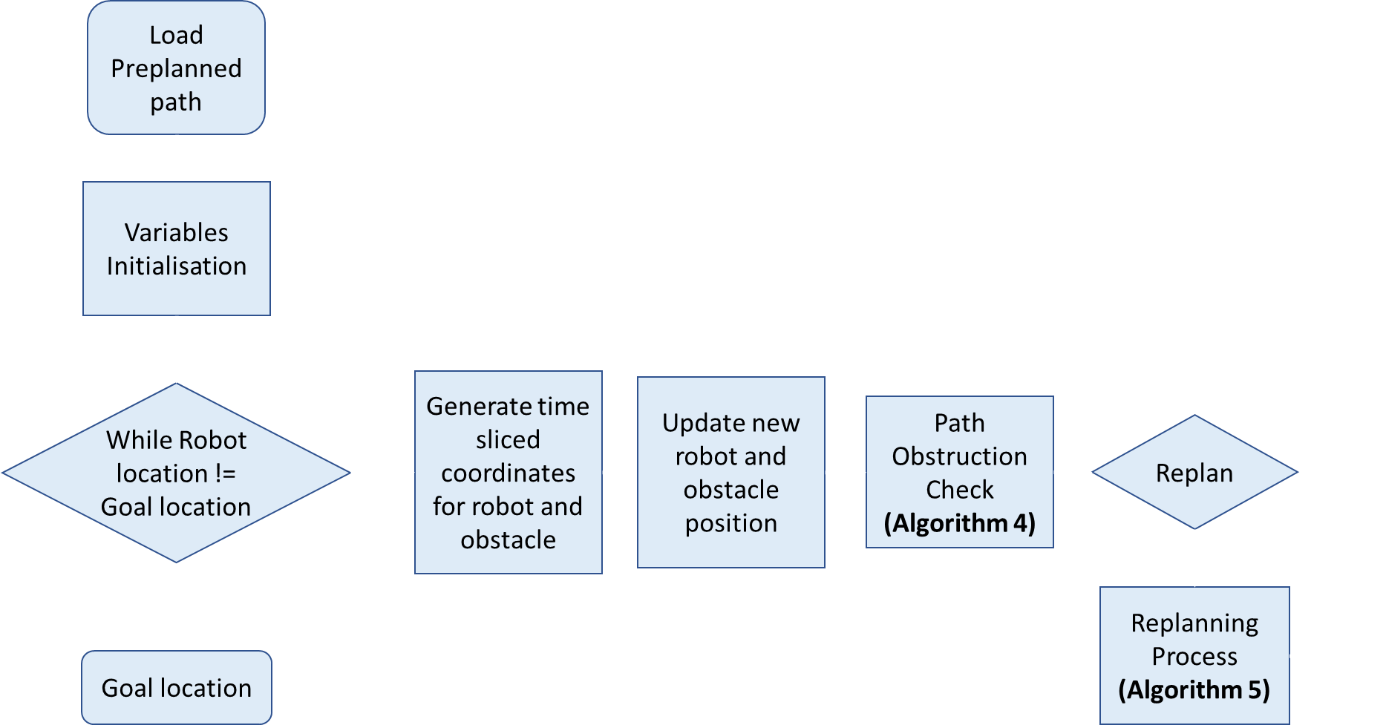
Dynamic Path Replanning in 2-D
Overall Path Execution
1.
2.
4.
5.
3.
6.
Notes:
This is the overall path execution flowchart. The preplanned path will be loaded first followed by initialisating important variables such as obstacle vertices for the obstacle to travel between. The shape, size and speed of obstacle and robot is also initialized. The algorithm will then go into a loop that executes until the robot reaches its destination. The robot and obstacle are plotted on a frame by frame basis and whenever the obstacle comes into the detection range of the robot, a path obstruction check will be done. Depending on the scenario, a replan event will be triggered and the replan process will run. The loop then repeats until the robot reaches its destination. The path obstruction check and replanning process will be discussed in further detail.

Slide 14
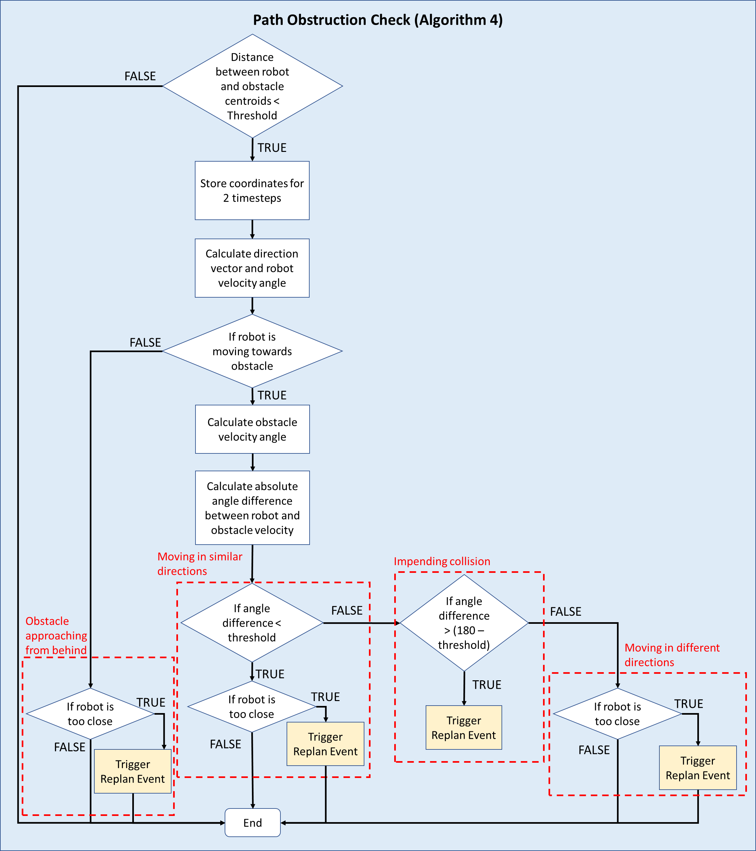
Path Obstruction Check (2-D)
Trigonometry Principles employed to obtain robot and obstacle velocity angles
4 main scenarios as depicted
Robot moving towards obstacle
Obstacle approaching robot from behind
Notes:
The path obstruction check uses trigonometry principles to obtain robot and obstacle velocity angles. These angles together with the proximity data will help the robot to decide its next course of action whenever the obstacle comes into its detection range. There are 4 main scenarios, 3 happens when the robot is deemed to be moving towards the obstacle and one for the case where the obstacle is approaching the robot from behind.

Slide 15
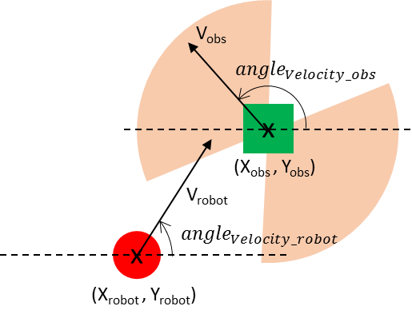
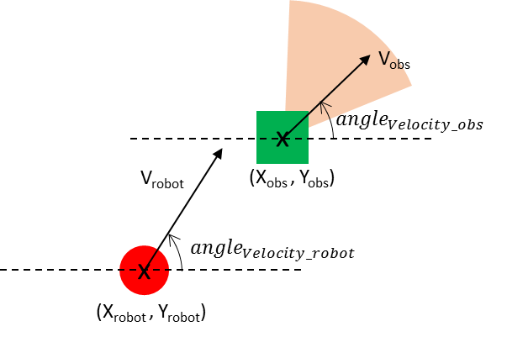
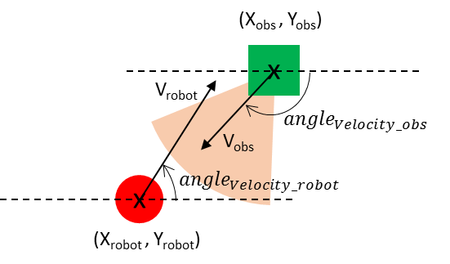
Path Obstruction Check (2-D)
$${angle}_{velocity difference}=\left|{angle}_{Velocity_robot}− {angle}_{Velocity_obs}\right|$$
Neither Scenario 1 nor 2
< angle_{threshold}
> (180º – angle_{threshold})
Scenario 1
Scenario 2
Scenario 3
Obstacle
Obstacle
Obstacle
Robot
Robot
Robot
Moving in similar directions
Moving towards each other
Moving in different directions
Shaded area represents all potential V_{obs} for each scenario
Notes:
For the three cases where the robot is deemed to be moving towards the obstacle. The absolute angle difference between the robot and obstacle velocities will sort the interactions into the 3 different scenarios. If it is less than the threshold angle, the robot and obstacle are moving in similar directions. If it is larger than 180 – threshold angle, the robot and obstacle are moving towards each other. Otherwise, the robot and obstacle are deemed to be moving in different directions. No replan event will be triggered for the first and 3rd scenario unless the robot and obstacle gets too close. Scenario 2 will immediately trigger a replan event.

Slide 16
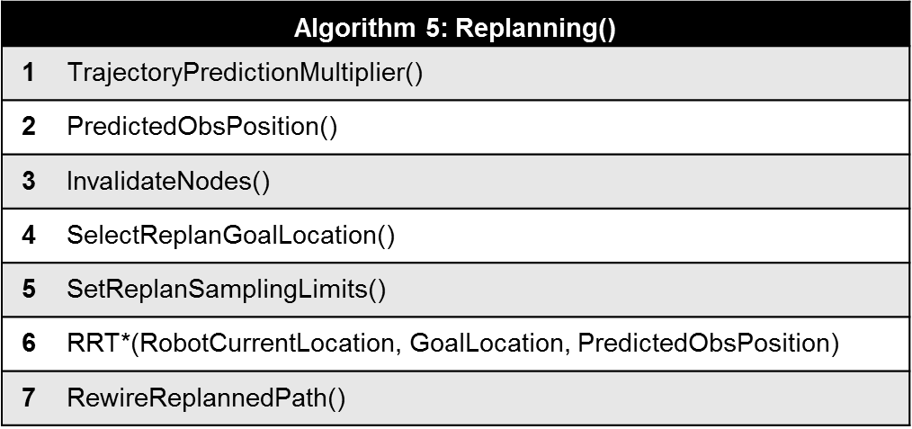

Replanning Algorithm
Prediction multiplier proportional to the distance between robot and obstacle
$$Predicted obstacle coordinates=(X_{obs}, Y_{obs})+multiplier∗V_{obs}$$
RRT* localised replanning
Algorithm 5: Replanning()
1 | TrajectoryPredictionMultiplier()
2 | PredictedObsPosition()
3 | InvalidateNodes()
4 | SelectReplanGoalLocation()
5 | SetReplanSamplingLimits()
6 | RRT*(RobotCurrentLocation, GoalLocation, PredictedObsPosition)
7 | RewireReplannedPath()
Notes:
When a replan event is triggered, the replanning algorithm will run in this manner. First is the determination of the prediction multiplier. It will be propotional to the distance between the robot and the obstacle. Next, predicted obstacle position is determined with the formula as shown. After that, nodes around the predicted obstacle location will be invalidated and the new replan goal and sampling limits will be determined. Localised RRT* replanning will be then run with the inputs calculated above. Finally, the replanned path will then be wired back to the existing path. The robot will then follow this new replan path which avoids the moving obstacle and eventually links back to the original preplan path.

Slide 17
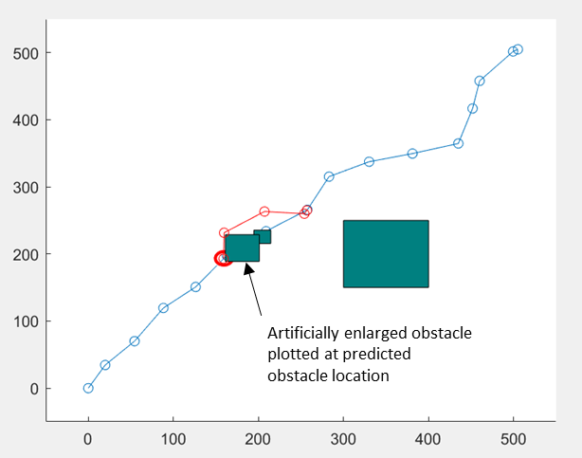
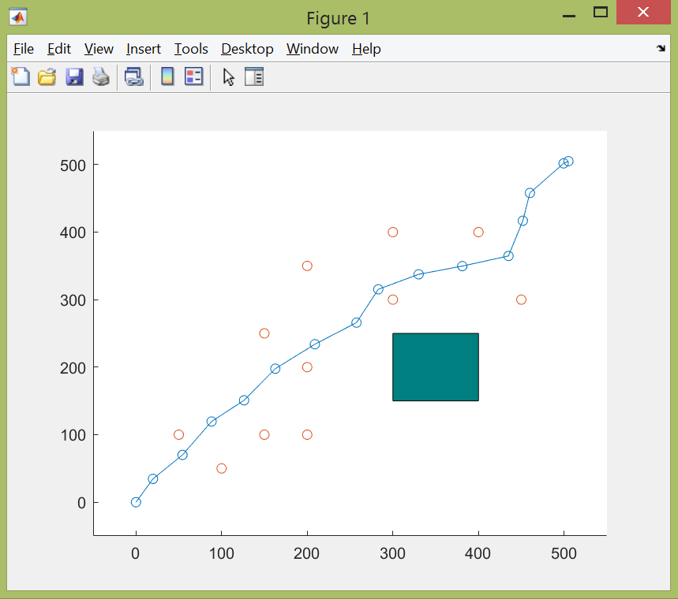
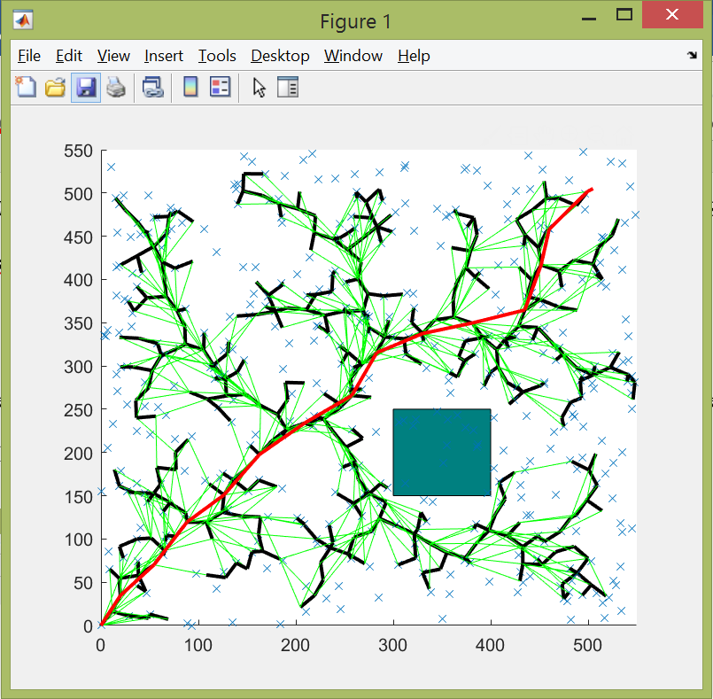
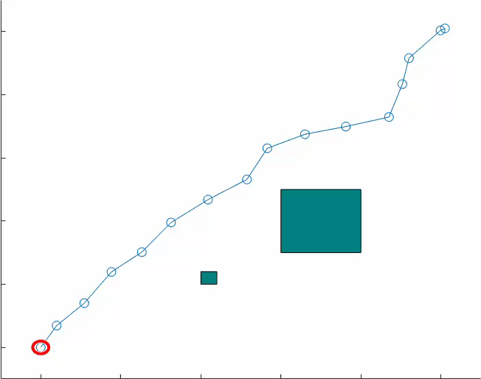
Matlab Simulation
Generation of global preplanned path using RRT*
Reused for all subsequent runs
o represents the nodes that the obstacle can travel between
Notes:
In the matlab simulation, a preplanned global path will first be generated and reused for all subsequent runs.
These are the different vertices that the obstacle can travel between. There are ample opportunities for the moving obstacle to cross path with the robot to test the replanning algorithm. The artificially enlarged obstacle plotted at the predicted location helps to deflect the replan path away from the incoming obstacle. here is an example run.

Slide 18

4.
3-D DEVELOPMENT
An additional dimension of complexity
Notes:
After the 2-D replanning algorithm is done, it is augmented to be implemented in a 3-D environment

Slide 19
Dynamic Path Replanning in 3-D
Overall Path Execution
Path Obstruction Check (Algorithm 6)
Notes:
The structure of the overall path execution remains the same but have to take into account the additional dimension for both the robot and obstacles.

Slide 20
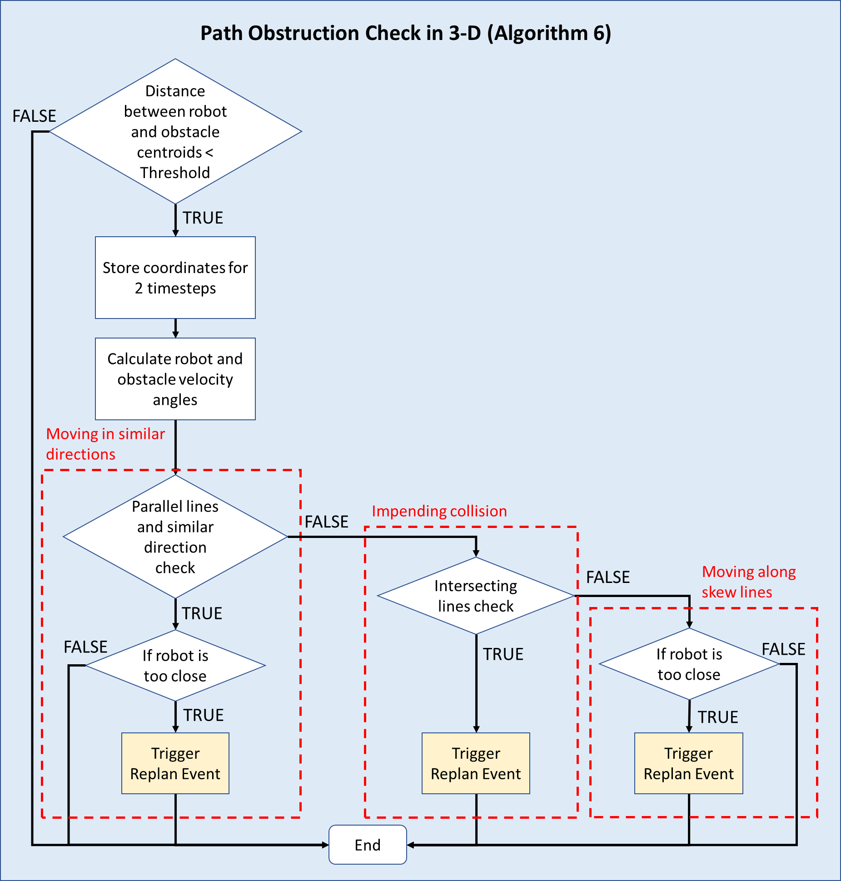
Path Obstruction Check (3-D)
Path Obstruction Check Algorithm Flow Chart
Notes:
As both the robot and obstacle can move in any direction in 3-D space, a more robust path obstruction check algorithm will be required as compared to the 2-D version. A detection sphere is created around the robot and whenever the obstacle enters the detection sphere for at least 2 time steps, the robot will sort the robot obstacle interaction into 3 different cases and determine the next course of action.

Slide 21
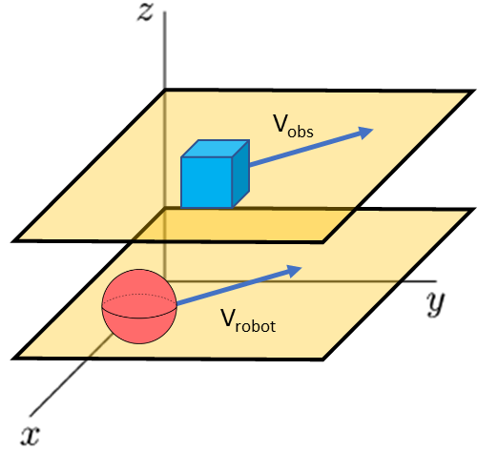
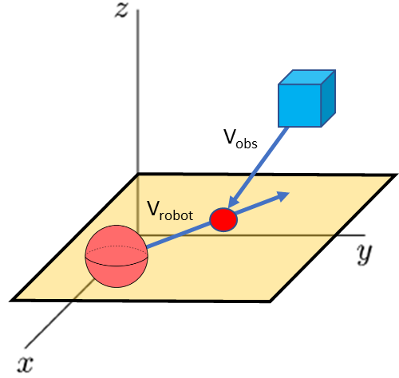
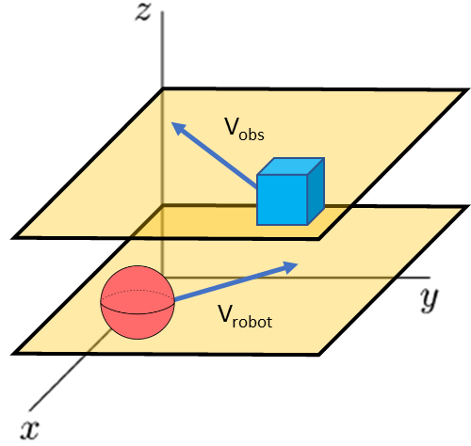
Path Obstruction Check (3-D)
Case 1
Case 2
Case 3
Parallel lines
Intersecting lines
Skew lines
Notes:
By modelling the velocity vectors of the robot and obstacle into 2 straight-line paths trajectory and analyzing them as lines, the infinite number of interactions between the robot and obstacle in 3-D space can be classified into these 3 distinct cases corresponding to parallel lines, intersecting lines and skew lines.

Slide 22
Case 1: Moving in Similar Directions (Parallel lines)
Parallel Lines & Similar Direction Check
TRUE
FALSE
Check proximity
Check Case 2
Too close
Trigger Replan Event
Continue on preplanned path
Notes:
For Case 1, a Parallel Lines & Similar Direction Check is done.
If its true, the robot and obstacle are moving in similar directions. The robot will ignore the obstacle and continue following its preplanned path unless it gets too close. A replan event is only triggered when they are too close. Otherwise, it will move on to check case 2

Slide 23
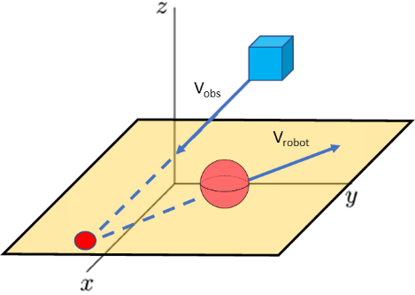
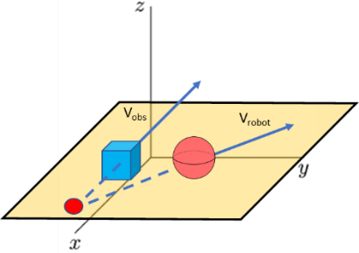
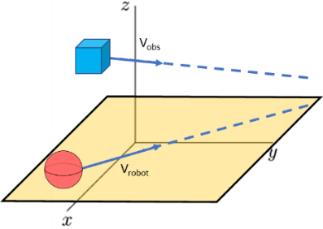

Case 2: Impending Collision (Intersecting lines)
Intersecting Lines Check & Intersection Point Position Check
TRUE
FALSE
$$\left[\begin{matrix}t \\ s\end{matrix}\right]= {\left[\begin{matrix}V_{x_{obs}} −V_{x_robot} & \\ V_{y_obs}−V_{y_robot} & \\ V_{z_obs}−V_{z_robot} & \end{matrix}\right]}^{−1}\left[\begin{matrix}X_{robot}− X_{obs} \\ Y_{robot}−Y_{obs} \\ Z_{robot}−Z_{obs} \end{matrix}\right]⟺ x=A^{−1}b$$
Trigger Replan Event
Move on to Case 3
Notes:
For case 2, the intersection point can be calculated by equating both the path trajectory lines of the robot and obstacle and solving it in a system of linear equation in matrix form Ax = b. The additional intersection point position check is to ensure that the collision point lies infront of the robot path and is not too far away unlike these 3 examples here. If everything is true, the replan event is triggered as an impending collision will take place. Otherwise it will move on to case 3

Slide 24
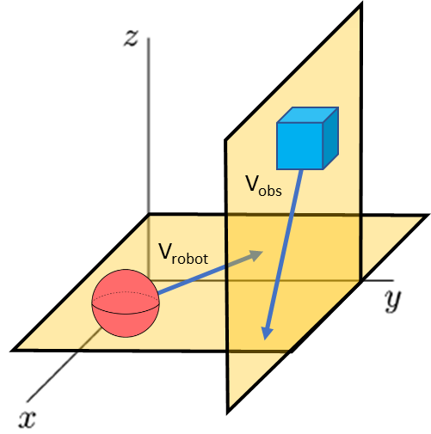
Case 3: Moving in Different Directions (Skew lines)
Robot and obstacle moving along skew lines
Proximity Check
Too close
Trigger Replan Event
Continue on preplanned path
Notes:
Finally, the last case where the robot and obstacle are moving along skew lines, it unlikely for the robot to collide with the moving obstacle if both robot and obstacle continue on their path trajectory. The robot will ignore the obstacle and continue following its preplanned path unless it gets too close.

Slide 25
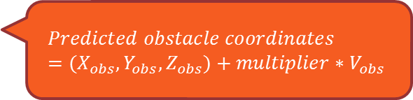
Replanning Algorithm (3-D)
$$Predicted obstacle coordinates=(X_{obs}, Y_{obs},Z_{obs})+multiplier∗V_{obs}$$
3-D RRT* localised replanning
Algorithm 5: Replanning()
1 | TrajectoryPredictionMultiplier()
2 | PredictedObsPosition()
3 | InvalidateNodes()
4 | SelectReplanGoalLocation()
5 | SetReplanSamplingLimits()
6 | RRT*(RobotCurrentLocation, GoalLocation, PredictedObsPosition)
7 | RewireReplannedPath()
Notes:
The replanning algorithm retains a similar logic structure as the 2-D implementation but have to account for the third dimension which makes the replanning process more complex.

Slide 26
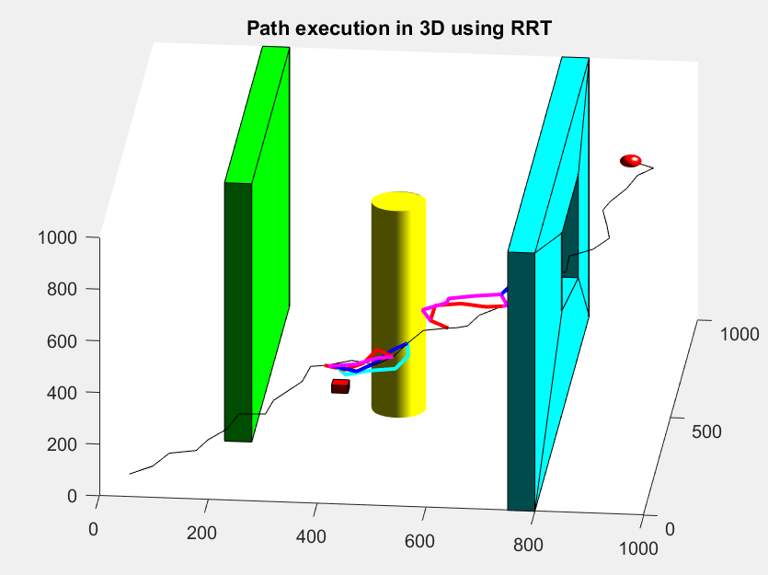
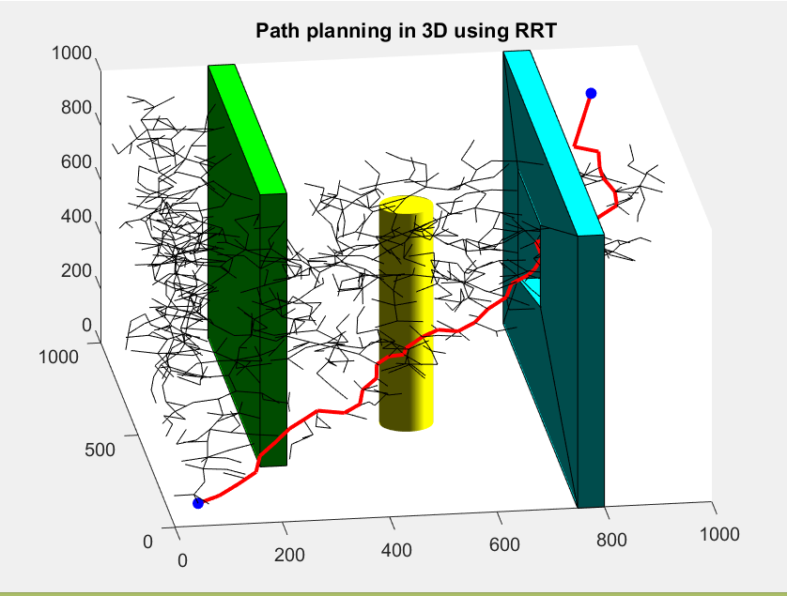
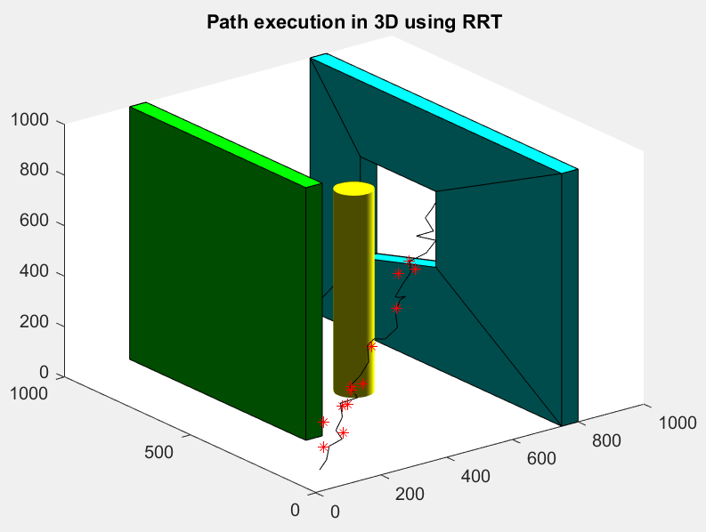
Matlab Simulation (3-D)
Generation of global preplanned path using RRT*
Reused for all subsequent runs
* nodes that the obstacle can travel between
Notes:
In the matlab simulation, a preplanned global path will first be generated and reused for all subsequent runs. The static obstacles will remain the same for all subsequent runs as well.
These are the different vertices that the obstacle can travel between. There are ample opportunities for the moving obstacle to cross path with the robot. This is an example of a completed run with the replan paths plotted in colour.

Slide 27
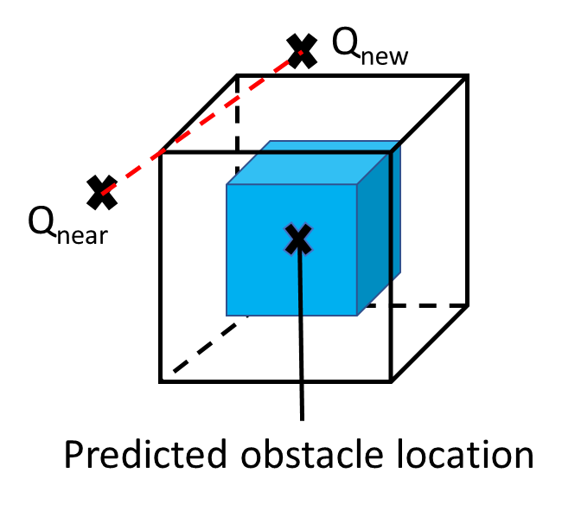
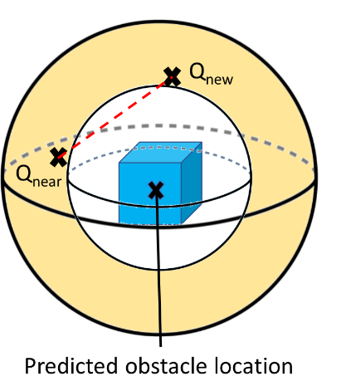
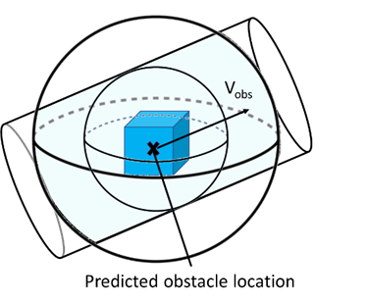

Iterative Improvements to Replanning Algorithm
RRT* collision check method improvement
Line-Plane intersection check
Bounding Sphere collision check
Space-Time Volume Representation collision check
Collision rate: > 20%
Collision rate: ~10%
Collision rate: ~1%
Notes:
Throughout the development of the replanning algorithm, iterative improvements were done to the path replanning collision check method. Initially, a simple line-plane intersection check was done on an artificially enlarged obstacle but this led to other problems and a high collsion rate of above 20% in simulation runs. It was later improved to use a bounding sphere collision check method which lowered collison rates to about 10%. Finally, a space-time volume representation collision check was done to better account for the time dimension of the moving obstacle. The space-time volume is created by sliding the bounding sphere along the obstacle velocity vector about its predicted location. Collision rate fell to about 1% after implementing it.

Slide 28
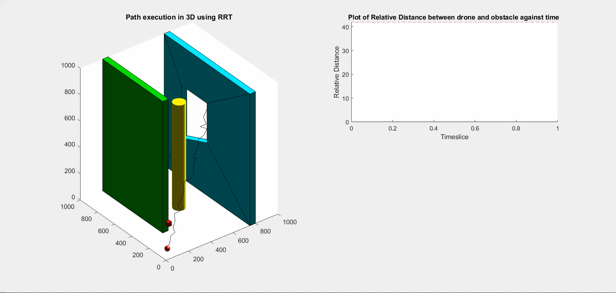
Simulation Trial with Final Replanning Algorithm
Notes:
Here is a simulation trial run example using the final algorithm

Slide 29

Final Replanning Algorithm Simulation Results (RRT* vs RRT)
Simulation | A (RRT*) | B (RRT)
Collision Rate | 1.2% | 0.4%
Average Replanning Time | 157.25 ms | 57.96 ms
% Replanning Time exceeding acceptable real-time limit (400ms) | 9.13% | 1.73%
% Replan Failures | 0.428% | 0.197%
Optimal path
Notes:
The final iteration of the replanning algorithm was able to achieve promising results with only 1.2% collision rate out of 500 runs. Average replanning time is about 160 ms, way below the real-time limit of 400ms. Only 9% of replans exceeded the real-time limit and less than 0.5% of the replans resulted in a failure where no solution could be found.
This performance was compared against a replanning algorithm that is based on RRT and we can see the performance metrics related to time has improved significantly. Collision rate improvement could have just been a random chance.

Slide 30
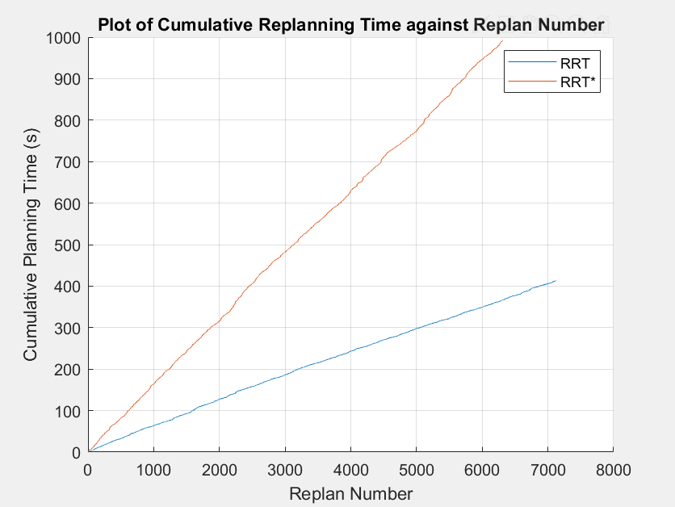
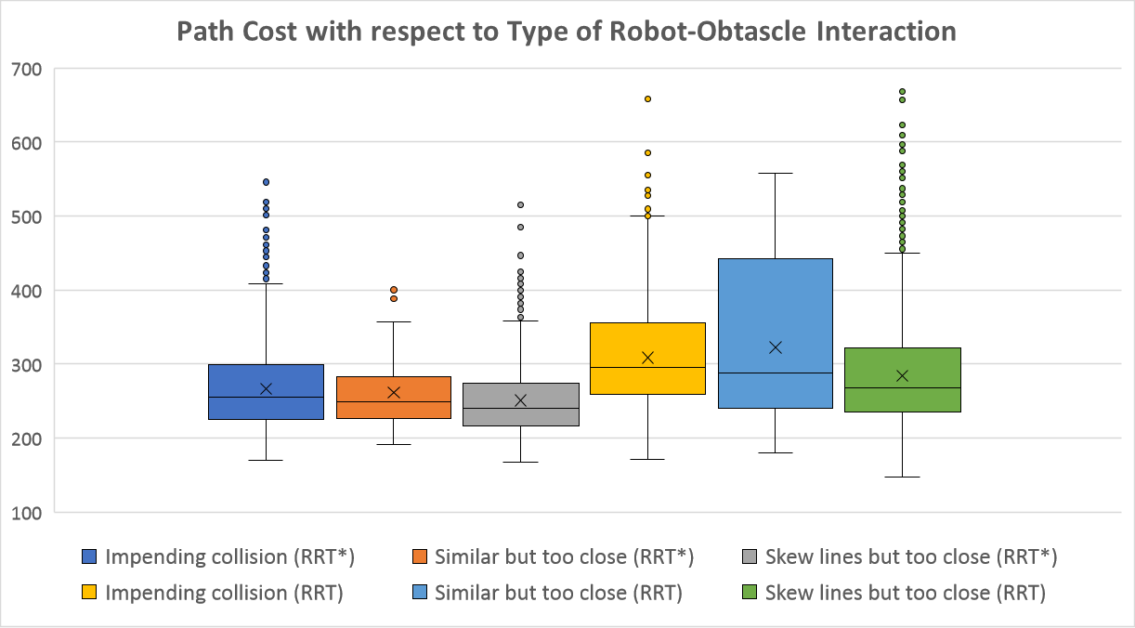
Results analysis
RRT
RRT*
RRT*
RRT
Notes:
The cumulative replanning time plot shows that RRT based replanning is consistently faster than RRT* based replanning. From the gradients, it is estimated to be about 2.5 times faster. From the boxes and whiskers plot, the average path cost for RRT* replans is lower for all three types of interaction with a smaller spread in variability. These 2 charts is consistent with the theory that RRT* is a more optimal but slower variant of RRT.

Slide 31
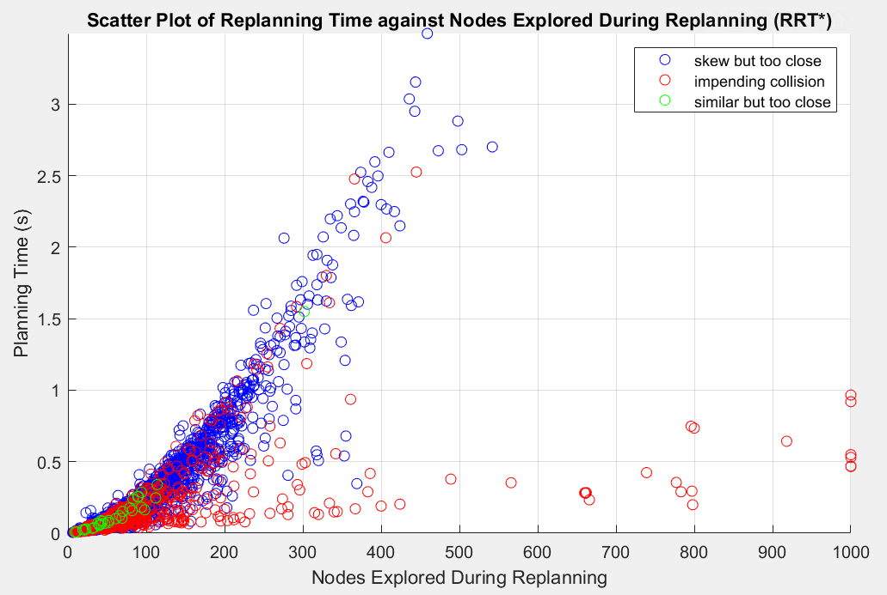
Results analysis
Findings
Despite exploring more nodes in cases of impending collision, lesser replanning time is required
If >1000 nodes are explored (<0.5% of cases), path planning will aborted = replan failure
Skew line interactions contribute most to long replanning time exceeding real time limit of 400ms
Notes:
Solution include strictly enforcing the real-time limit together with escape or safety strategies incase of replan failures

Slide 32
5.
Conclusion
Summing Up
Notes:
Finally, to sum up and conclude on the project.

Slide 33
Conclusion
Literature Review
Existing Path Planning Algorithms
Comparison, Evaluation & Selection
Dynamic Path planning Algorithms
3-D Development
Overall Path Execution
Path Obstruction Check Algorithm with 3-D geometry principles
Replanning Process
Results
~ 99% successful runs without collision
> 90% of replans within 400ms
Replan failures < 0.5%
2-D Development
Overall Path Execution
Path Obstruction Check Algorithm with trigonometry principles
Replanning Process
Matlab Simulation & Iterative Improvements
RRT* Collision Check improvements
Debugging
Future Work
Use dynamic planning methods
Parallel processing platform for simulation such as ROS
Going beyond the scope
Notes:
Restarting from the beginning, after the project objectives were set, literature review was done to learn from existing research. Next, the replanning algorithm was developed in a 2-D environment followed by augmenting it for 3-D implementation. Matlab simulation was done with iterative improvements to the algorithm. Promising results were achieved with about 99% successful runs without collsion, more than 90% within realtime limit and less than 0.5% replan failures. Future work could include employing more recent dynamic planning methods, implementation on ROS for a parallel processing platform and finally going beyond the scope defined for this project.

Slide 34
THANK YOU!
Any Questions?
Notes:
I have come to the end of my presentation, thank you for your attention.

Slide 35
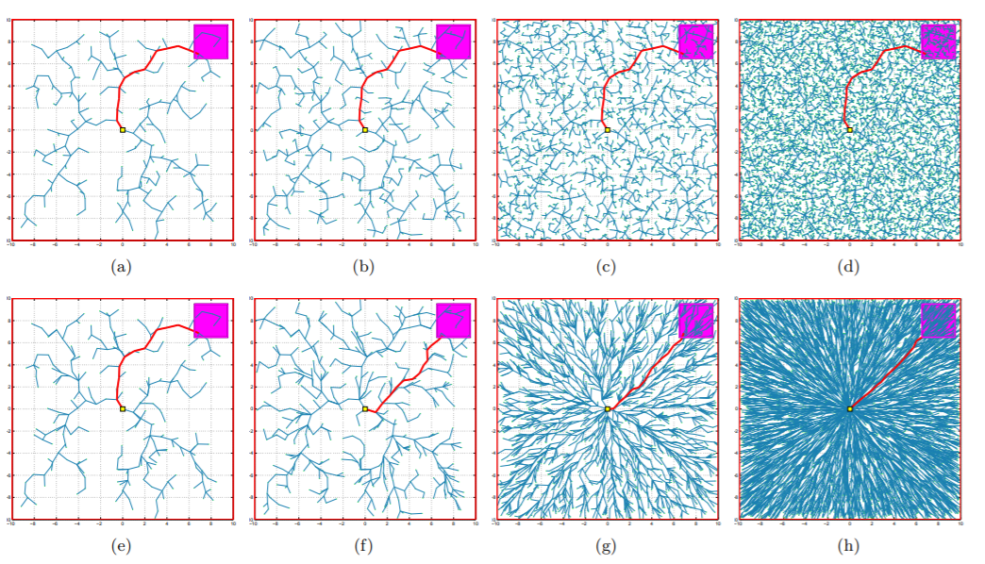
RRT vs RRT*

Slide 36
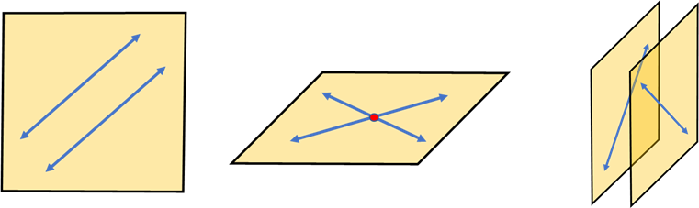

Slide 37
Collision Analysis
Due to consecutive replan failures
Solution
A safety strategy such as stop and wait, backtracking or another safety path can be employed to reduce the occurrence of collision due to replan failure. Alternatively, increasing the detection range and safety threshold to trigger a replan event will allow for more opportunities for replan, mitigating the issue of replan failure.
Abrupt change in direction of the obstacle velocity towards the robot when the robot and obstacle are in relatively close proximity of each other.
Solution
Increase space time volume representation and detection range. Allowing a change of speed also helps

Slide 38
Discussion points
1.

